Slide 1

Enhanced Sentiment-Aware Information Retrieval System Presentation
By: Ace Shah, Faria Promi
Course: Computer Systems Technology CST 4802 (Information Retrieval)

Slide 2

Introduction and Objectives
Sentiment-Aware Retrieval
Interactive Tool
Provides an interactive dashboard for exploring review data.
This system analyzes hotel reviews to understand customer sentiment.
Data-Driven Insights
Offers valuable insights for hotel management and decision-making.

Slide 3
Step 1: Importing Libraries
Import Libraries
1
Import necessary libraries for data analysis, sentiment analysis, and visualization.
Load Dataset
2
Load the hotel review dataset for analysis.
Data Preprocessing
3
Clean and prepare the data for analysis.

Slide 4




Step 1: Importing Libraries
Purpose
Load essential Python libraries and frameworks.
Libraries Used
Streamlit
Pandas
NLTK & TextBlob
Sklearn
WordCloud & Matplotlib
Code Example
import pandas as pd
import nltk
from sklearn.model_selection import train_test_split
from sklearn.feature_extraction.text import CountVectorizer
from nltk.sentiment.vader import SentimentIntensityAnalyzer

Slide 5



Step 2: Loading Dataset
Dataset Source
1
Kaggle hotel review dataset
Dataset Structure
2
Hotel\_Name, Review\_Date, Combined\_Review, Hotel\_Address
Data Processing
3
Sampled for faster performance
The dataset is loaded from a CSV file and a sample is taken for faster performance. The sample preview is shown on the dashboard.

Slide 6

Step 3: Data Preprocessing and Cleaning
1
Remove Null Values
Eliminate missing or incomplete data points.
2
Convert Date Format
Transform Review\_Date to a datetime format for analysis.
3
Extract Address Information
Isolate country and city from Hotel\_Address for location-based insights.

Slide 7
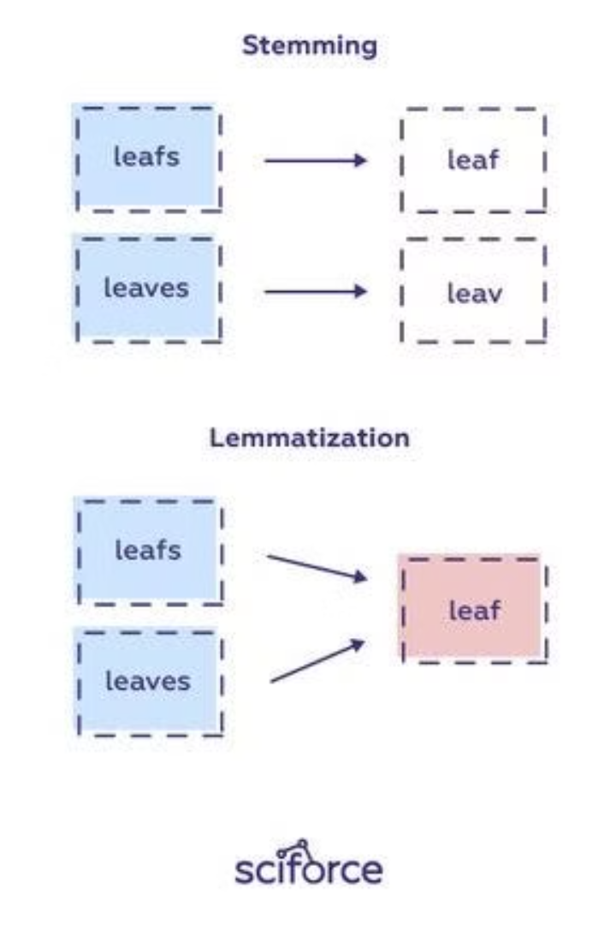
Step 4: Tokenization and Stemming
1
Tokenization
Reviews are split into individual words.
2
Stemming/Lemmatization
Words are normalized to their base form.
3
Tools Used
NLTK library is used for tokenization and stemming.

Slide 8




Step 5: Sentiment Analysis
Sentiment Score
1
Assign a sentiment score to each review.
VADER
2
Rule-based sentiment analyzer.
TextBlob
3
Polarity-based sentiment scoring.
Naive Bayes Classifier
4
Trained for positive/negative labels.

Slide 9

Step 6: Query Processing
The system accepts long queries and handles typos using fuzzy matching.
It supports AND and OR logic in queries.
BM25 ranking calculates relevance scores based on user input.

Slide 10

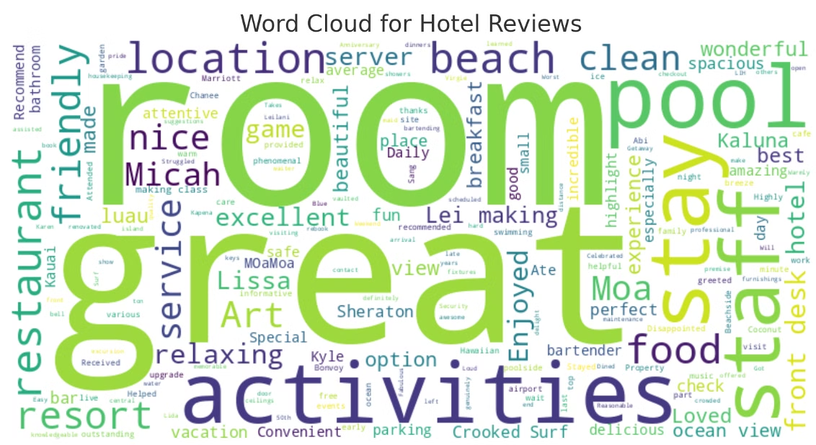
Step 7: Word Cloud Visualization
This visualization helps understand the most common words in reviews for a given sentiment.
Users can filter reviews by a specific hotel or sentiment (positive or negative) to see the most frequently used words.
This feature provides a quick and intuitive overview of customer feedback for a specific hotel or sentiment.

Slide 11
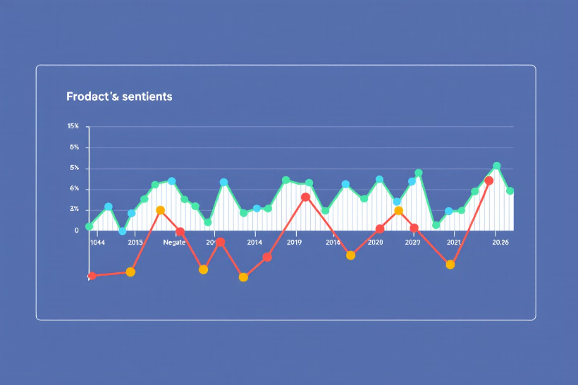
Step 8: Sentiment Trends
Visualize sentiment trends over time.
Analyze sentiment changes across different periods.
Identify patterns and potential drivers of sentiment shifts.

Slide 12
Sentiment Trends
Purpose
1
Analyze sentiment trends over time for specific hotels.
Visualizations
2
Quarterly averages for VADER and TextBlob scores.
Review counts over time.
Annotations
3
Highlight the highest positive and negative sentiment periods.

Slide 13
Step 9 - Interactive Dashboard
Streamlit: A Powerful Tool
Dashboard Components
Streamlit is a Python library used to build interactive dashboards.
Query input box
Sentiment and location filters
It enables rapid development of data-driven applications.
Dynamic visualizations (bar charts, word clouds)
The framework allows users to build web interfaces with just a few lines of code.
These features provide a comprehensive and interactive way to explore data.

Slide 14





Challenges and Solutions
Data Quality
Algorithm Optimization
Ensuring data accuracy and completeness is crucial for effective analysis.
Fine-tuning algorithms to achieve optimal performance and accuracy.
Data Security
Scalability
Protecting sensitive user data and maintaining privacy.
Handling large datasets and increasing user traffic efficiently.

Slide 15

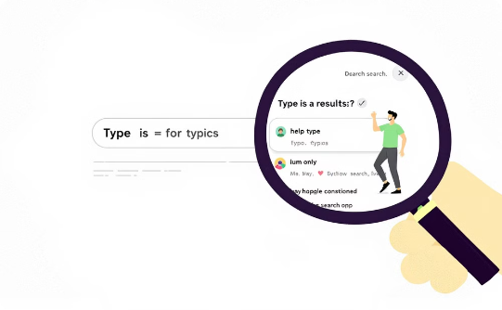

Challenges and Solutions
Handling Large Queries
Typo Tolerance
Performance
BM25 algorithm was implemented for relevance ranking.
FuzzyWuzzy library was used for query matching.
Streamlit's @st.cache_data was used to cache intermediate results.

Slide 16

Conclusion and Future Enhancements
The system successfully integrated sentiment analysis and information retrieval.
Future enhancements include multilingual support and improved machine learning models for greater accuracy.

Slide 17

Code Repository
Access our code repository for a comprehensive look at the implementation. It includes detailed steps on data preprocessing, sentiment analysis, and visualization.
Here’s the GitHub link to our project, complete with the code and clear instructions on how to run it.

